Slide 1
Tec de Monterrey Hello Robot KeyPrediction
Final Project:
Stretch Proof of Concept
Feasibility Demonstrations & Design Pitch Frameworks

Slide 2
Tec de Monterrey KeyPrediction
The Pitch Strategy
Build a convincing proof-of-concept demonstration rather than a finished, production-ready system.
Identify a practical real-world application domain use case.
Validate feasibility given specific robot hardware boundaries.
Deploy inside the stretch_mujoco_digital_twin environment.

Slide 3
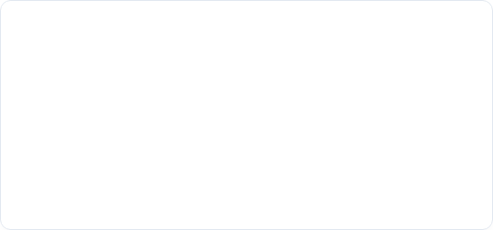

Hello Robot KeyPrediction
Potential Application Paths
Explore any domain making genuine use of Stretch capabilities:
Assistive Systems
Sorting & Logistics
Helping individuals with limited structural mobility execute everyday foundational lifestyle tasks safely.
Advanced object manipulation, structured workspace sorting, navigation, and fetch-and-carry tasks.

Slide 4
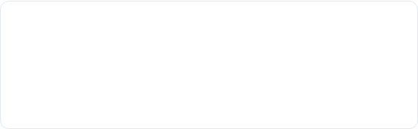
Tec de Monterrey Hello Robot
Core Evaluation Layout
The total score is divided across four equally-weighted metric branches:
Idea & Feasibility (25%)
Implementation (25%)
Is the domain scope appropriately ambitious yet technically bounded?
Does the solution code make robust, genuine use of autonomous design metrics?
Presentation (25%)
Video Delivery (25%)
Is the live or recorded pitch argument clear, convincing, and structured?
Does the video media clearly explain operation logic without auxiliary text?

Slide 5

Tec de Monterrey Hello Robot KeyPrediction
Submission Requirements
The Written and Digital Deliverables
1. System Code: Clean executable scripts targeting the digital twin platform.
2. Project Report: Written project report detailing design choice choices.
3. Pitch Video: Explanatory project video demonstrating runtime success parameters.

